Slide 1




NEXT GEN EMPLOYABILITY PROGRAM
Creating a future-ready workforce
Team Members
College Name
Student Name : A.Indhuja
Student ID : au951221104012
JP College Of Engineering

Slide 2

CAPSTONE PROJECT SHOWCASE
Project Title
Voting Web Application using Django Framework
Abstract | Problem Statement | Project Overview | Proposed Solution | Technology Used | Modelling & Results | Conclusion

Slide 3
Abstract
The Django-based Voting Web Application is a robust platform designed to facilitate democratic processes, opinion gathering, and decision-making through digital voting mechanisms. Built on the Django framework, it leverages the flexibility and scalability of Python to provide a secure and user-friendly voting experience.
Key features include user authentication, poll creation, secure voting interfaces, result visualization, robust security measures, auditing capabilities, scalability, customization options, and feedback mechanisms. It aims to provide organizations, communities, and governments with a comprehensive platform for conducting transparent and accessible voting processes online.
Source :

Slide 4
Problem Statement:
Creating a Django-based voting web application that not only ensures secure and accessible digital voting but also effectively manages concurrent user interactions, maintains data integrity, and provides real-time result updates to enhance the overall user experience.
.
Source :

Slide 5
Project Overview
Project Overview:The Django-based voting web application aims to provide a robust platform for conducting digital voting processes. Key components include user authentication, poll creation and management, secure voting interfaces, result visualization, security measures, auditing capabilities, scalability features, and user feedback integration..
Project setup
App creation
Database models
Admin interfaces
User authentication
Poll creation
Voting and results display
Front end design and URL routing
Testing and deployment

Slide 6
Proposed Solution
The proposed solution involves leveraging Django's built-in authentication system for secure user registration and login functionalities. Poll creation and management will be facilitated through Django models and forms, allowing administrators to customize voting options and schedules easily. Secure voting interfaces will be implemented using Django templates and forms with CSRF protection to prevent unauthorized access.
.
Source :

Slide 7
Advantages
Django's built-in features like authentication, URL routing, and templating system allow for quick development of complex web applications.
Security: Utilizes Django's robust security features such as built-in user authentication, protection against common vulnerabilities, and encryption techniques to ensure secure voting processes and data integrity.
Scalability: Leverages Django's scalability features for handling large volumes of concurrent user interactions, making it suitable for organizations of varying sizes and voting needs.
Customization: Offers flexibility for customizing voting options, user roles, and interface design to meet specific requirements and branding preferences.
Ease of Development: Django's extensive documentation, built-in admin interface, and ORM (Object-Relational Mapping) simplify development tasks, speeding up the creation and deployment of the voting application.
Source :

Slide 8
Disadvantages
Learning Curve: Developing with Django may have a steeper learning curve for beginners compared to other frameworks, requiring familiarity with Python and Django's specific conventions and patterns.
Performance Overhead: While Django provides powerful features, its ORM (Object-Relational Mapping) may introduce performance overhead, especially when dealing with complex database queries or high-traffic scenarios.
Customization Limitations: While Django offers customization options, highly specific or unconventional requirements may require extensive customization, potentially leading to increased development time and complexity.
Version Dependency: Upgrading Django versions or migrating to newer releases may require adjustments to existing codebase and third-party packages, posing challenges for long-term maintenance and compatibility.
Source :

Slide 9




Technology Used
Front-end
Back-end
Source :

Slide 10
Modelling & Results
In developing a voting application using Django, meticulous attention is directed towards both modeling the underlying data structure and effectively presenting the voting results to users.
Through Django's model system, the application's data architecture is meticulously crafted, typically featuring models like Question and Choice to represent the polls and available choices.
Once users have participated in the voting process, conveying the results to them becomes paramount.
Leveraging Django's templating system, the application dynamically generates HTML templates that vividly present the voting outcomes in an intuitive and visually engaging manner.
Furthermore, the application may utilize charting libraries or custom visualization techniques to elucidate the distribution of votes across different options, offering users valuable insights into the voting process's outcome.
Source :

Slide 11
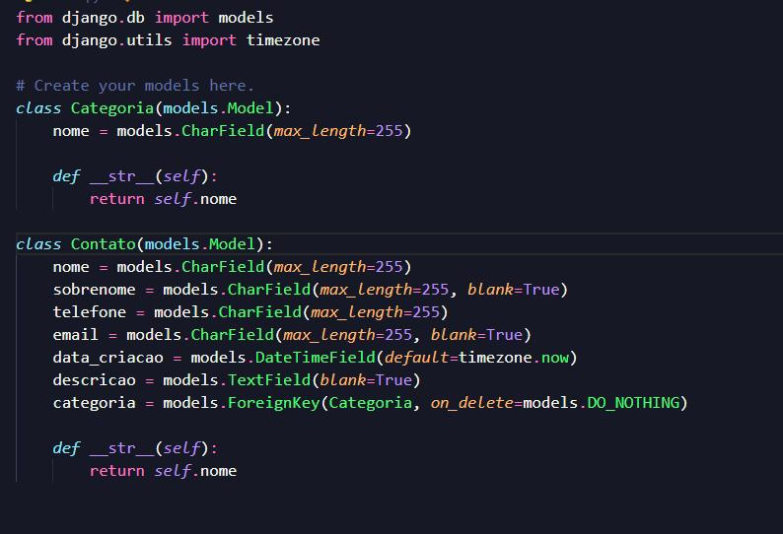
Homepage

Slide 12
About-Us-Page
1.Credibility: The "About Us" page establishes credibility by providing informationabout the organization's history, mission, and team members .
2.Mission and Values: It communicates the organization's mission, values, and objectivesin promoting democratic participation and decision-making.
3. Community Engagement: The page showcases the organization's commitment tocommunity engagement and empowerment through the voting process, inspiring active participation.
4. Contact Information: Users can easily reach out with questions, feedback, or inquiriesabout the voting application through the contact information provided on the page.

Slide 13
Service-Page
Header Section
Introduction section
User Services
Administrator Services
Organizational Services
Technical Services
Consulting Services
Call to Action Services

Slide 14
Departments-Page
Header Section
● Introduction Section
● Department Listings
● Department Details
● Key Personnel
● Collaboration Opportunities
● Footer Section

Slide 15
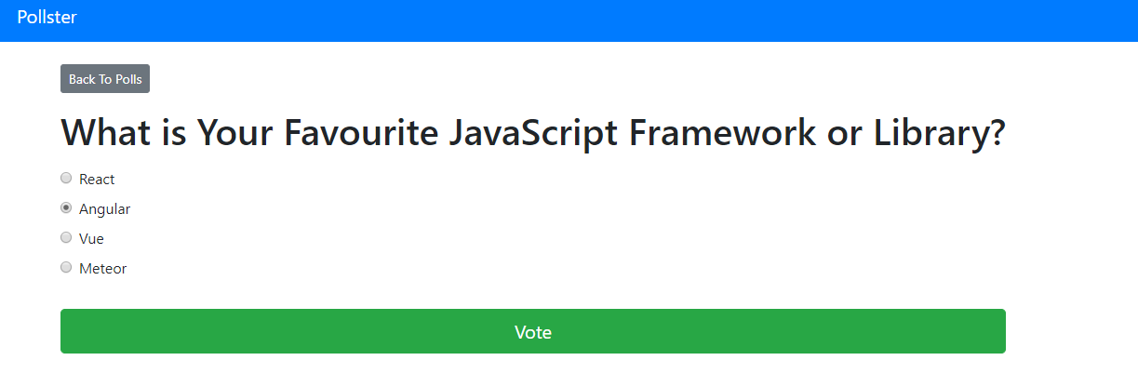
Blog-Page

Slide 16
Future Enhancements:
Utilize machine learning algorithms to analyze voting data, predict future trends, and provide personalized recommendations for users based on their voting history and preferences
Extend the voting application's reach by developing native mobile apps for iOS and Android platforms, offering a seamless and optimized experience for mobile users.
Explore integrating blockchain technology to enhance the transparency, security, and integrity of the voting process, ensuring that votes are immutable and tamper-proof.
Implement comprehensive reporting functionalities for administrators to generate detailed reports on voting patterns, demographics, and trends. This could include visualizations such as charts and graphs.

Slide 17
Conclusion
In conclusion, the Django-based Voting Web Application offers a robust and secure platform for conducting digital voting processes. Despite potential disadvantages such as a learning curve and performance overhead, its advantages in terms of security, scalability, customization, reliability, user experience, and community support make it a compelling choice for organizations seeking a dependable solution for online voting. With proper development and maintenance, the Django framework empowers users to engage in transparent and accessible democratic decision-making with confidence and convenience.
Source :

Slide 18
Thank You!
Notes:
Thank You !!

